Slide 1
Feedback Mechanism Schematic

Slide 2
The purpose of a schematic is to represent the parts of a system and how they connect/interact using graphic symbols.
Your assignment is to investigate a schematic that shows how the body uses feedback mechanisms to maintain homeostasis and relate these processes to events in your daily life.

Slide 3
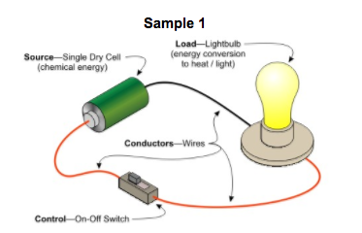
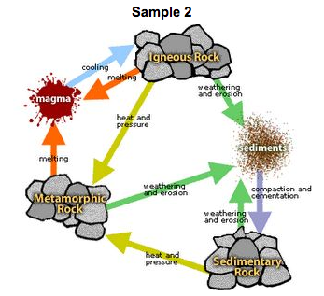
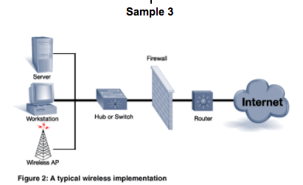
What is a schematic?
A schematic is a diagram to show the parts of a system and the relationships of those parts to each other.
Typically the parts are represented by pictures or symbols, but some schematics use only words and arrows.

Slide 4
Parts of a Schematic
Stimulus—something that causes change
Receptor/Sensor—detects the change
Control Center—receives information from receptor and sends information to effector
Effector—reduces the effect of the stimulus and returns the system to homeostasis
Arrow—shows the direction of action/order of steps in the process

Slide 5
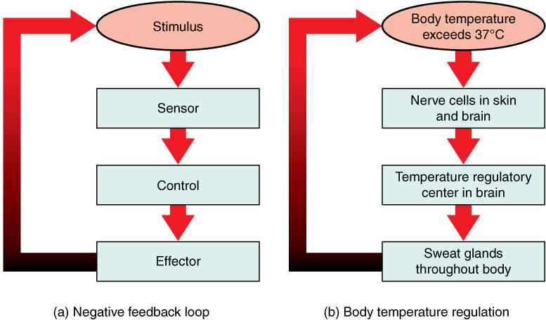

Slide 6
Maintaining Homeostasis
Homeostasis is how your body keeps things in balance
Homeostasis is the process by which organisms keep internal conditions relatively constant despite changes in external environments.
Living example—body temperature regulation
Non-living example—heating system of a house

Slide 7
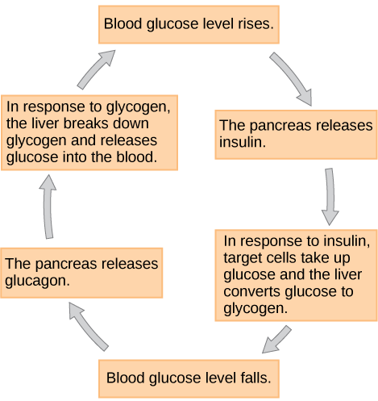
Feedback Inhibition
Feedback inhibition (negative feedback) – process in which a stimulus produces a response that opposes the original stimulus
Some of the properties kept in check are:
Body temperature
Blood glucose levels
Water potential
Oxygen and carbon dioxide concentrations

Slide 8
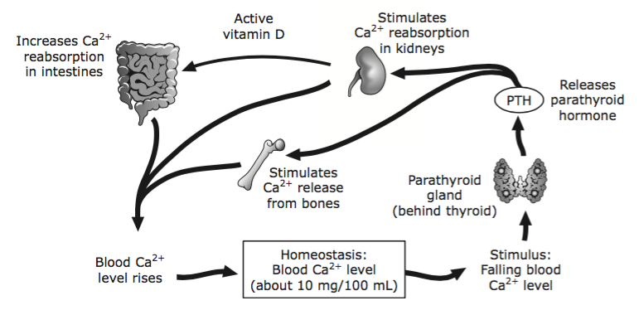
Schematic from STAAR

Slide 9
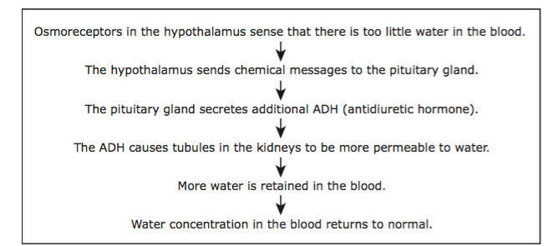
Schematic from STAAR

Slide 10
Examples of Feedback Mechanisms in the Human Body
You may choose one of these for your project or research another example.
Immune system response to pathogens
Blood pressure
Calcium levels in the blood
Cell division/Contact inhibition
Water balance (osmoregulation)
pH regulation in the blood
Glucose levels in the blood
Blood oxygen and carbon dioxide levels
Body temperature (thermoregulation)—include reactions to cold as well as hot conditions

Slide 11
Your Assignment
Go online and find an example of a feedback mechanism schematic in the human body. Cut and paste into google slides. (10 pts)
Identify the stimuli, sensors, controls and effectors in this system. (15 pts)
Reflect on feedback systems in your daily activities. This should not be another human body example, but one that reflects choices you consciously make in response to stimuli.
Draw a schematic and identify the stimuli, sensors, controls and effectors in this second system. (25 pts)
Using complete sentences and paragraphs, compare the human body feedback example to the example from your daily life. Use the terms stimuli, sensors, controls, effectors and homeostasis to fully explain these systems. (50 pts)
Submit this assignment on google classroom.

Slide 12
Daily Life Feedback Mechanism
Example
Stimuli: the dripping sound that my aquarium makes when the water level gets low
Sensors: my ears
Control: my brain
Effectors: I add water to the aquarium
Homeostasis: Nice quiet house; lack of annoying dripping sounds
Your Example
Stimuli: What do you see/hear/smell/feel/taste that lets you know something needs to be done?
Sensors: What detects this need?
Control: What receives the information from the sensors and decides how to respond?
Effectors: What makes the needed change?
Homeostasis: What are you trying to keep in balance?

Slide 13
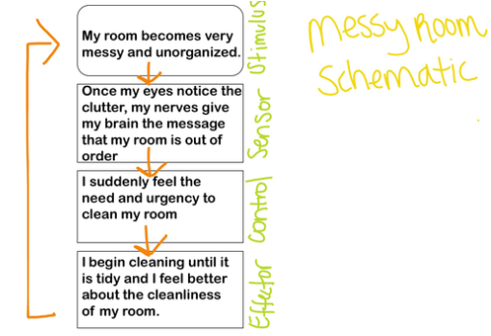
Examples

