Slide 1
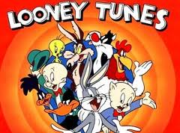
Looney Dichotomous Key

Slide 2
Dichotomous Keys
Dichotomous keys are used by scientists in the field to quickly identify species without having to look through pages and pages of pictures and read lengthy descriptions.
Each number has two lettered choices: “A” and “B”.
Always start with the first statement.
Choose the lettered choice that fits your organisms and follow the instructions.
Continue until you reach a species name.

Slide 3
Example One—Pepe Le Pew
Read statement 1.
Pepe does not have a bill so go to step 4.
He is not wearing a hat or helmet so go to step 7.
He has fur on his head. Go to step 8.
Short ears. Step 10.
Black on top and white on the bottom. Step 11.
Pepe has rounded ears, a black nose, a crest of fur on his head and likes to chase female cats with paint down their backs. Write his name as Jigaloe pickemupus.

Slide 4
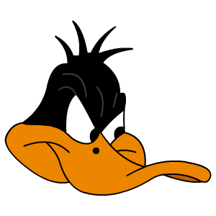
Example Two—Daffy Duck
Read statement 1.
Daffy has a bill so go to step 2.
He does not have eyelashes so go to step 3.
His bill is broad, smooth and rounded. Write his name as Chirpus dafficus.

Slide 5
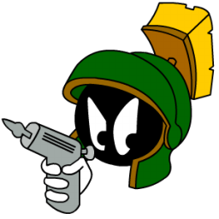
Example Three—Marvin the Martian
Read statement 1.
Marvin does not have a bill so go to step 4.
He is wearing a hat or helmet so go to step 5.
He has no nose and is wearing a cool-looking helmet with a scrub brush on top so write his name as Exitus outlandeous.

