Slide 1
Yeast Fermentation Lab

Slide 2
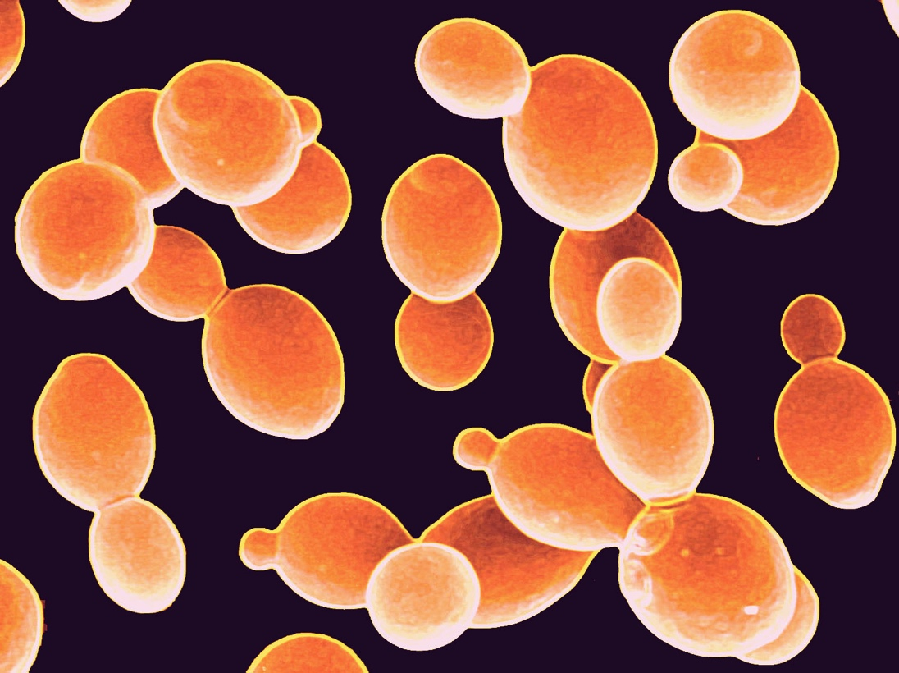
Purpose
To observe the effect of sugar amounts on yeast activity.

Slide 3
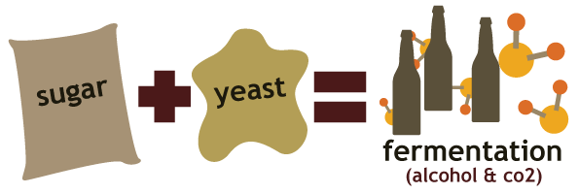
Background

Slide 4
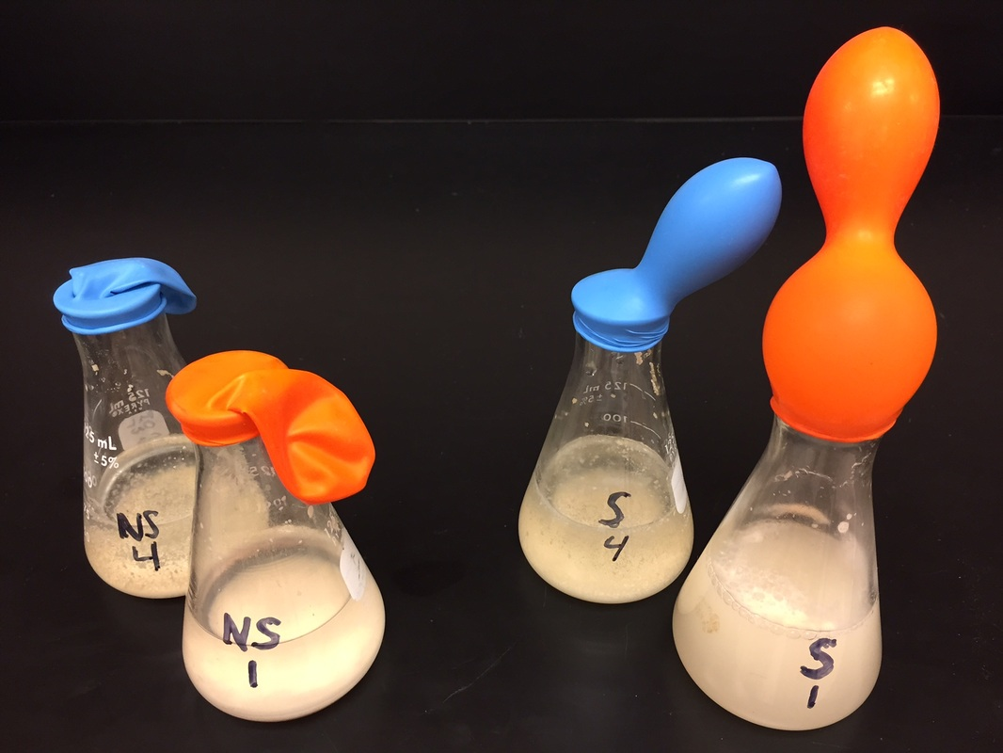
Materials
Dry active yeast
250 mL beakers
250 mL Erlenmeyer flasks
Balloon
Measuring tape
Sugar
Funnels
Warm water

Slide 5
Procedure
Fill the beaker with 100mL of warm tap water.
Add 2 ¼ teaspoons (1 packet) of yeast to the warm water and stir until it is in solution (dissolved.)
Add sugar to the Erlenmeyer flask according to your assigned group number.
Group 1—no sugar
Group 2—1/8 teaspoon sugar
Group 3—1/4 teaspoon sugar
Group 4—1/2 teaspoon sugar
Group 5—1 teaspoon sugar
Group 6—2 teaspoons sugar
Group 7—4 teaspoons sugar
Group 8—8 teaspoons sugar

Slide 6
Procedure continued
Carefully pour the yeast solution into the flask using a funnel.
IMMEDIATELY place the balloon over the mouth of the Erlenmeyer flask.
Note the time on your lab paper. This will be your start time.
Measure the circumference of the balloon at the start time and every 5 minutes after. Record the information on the data table.

Slide 7
Balloon Size Data Table
 | Start Time | 5 min. | 10 min. | 15 min. | 20 min. | 25 min.
Group 1
Group 2
Group 3
Group 4
Group 5

Slide 8
Graph
Make a graph of the data from your table.
(Which type of graph should be used?)
Appropriately title the graph and label all axes.
(Where does each variable belong?)
Each group must be in a different color. Include a key.

Slide 9
Conclusion
The conclusion is written using CER and in paragraph form.
C—Claim: statement of what you have learned/discovered
Refer back to the purpose of the lab if needed.
E—Evidence: data to support your claim
Relay the information from your chart.
R—Reasoning: justification that shows why the data counts as evidence to support your claim
Use appropriate scientific principles/vocabulary

