Slide 1
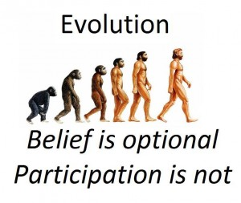
The Theory of Evolution

Slide 2
The theory of evolution
A scientific theory is an explanation for a set of observation or natural phenomena that has been repeatedly confirmed through experimentation and observations. Theory ≠ fact.
The theory of evolution states that all living organisms on Earth share a common ancestor and they have changed over time mostly through the process of natural selection.

Slide 3
Theories can change
Although scientific theories are supported by a large amount of evidence generated over a long period of time, a scientific theory may change if new evidence contradicts it.
A theory may be modified or completely rejected.

Slide 4
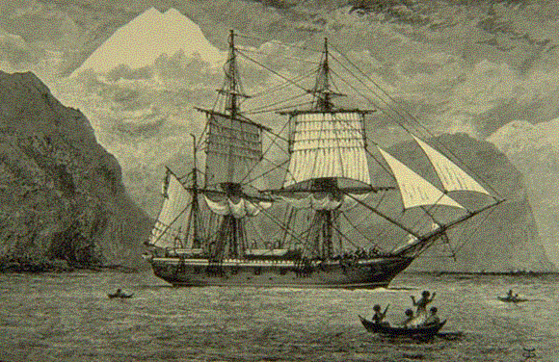
Charles Darwin
English naturalist
5 year expedition on the HMS Beagle in 1831

Slide 5
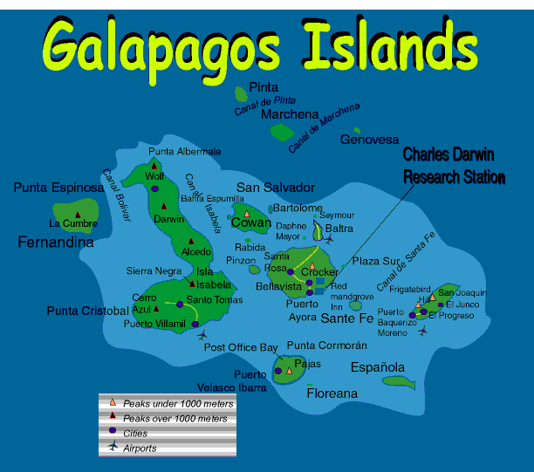
Charles Darwin
One of his most famous stops was the Galapagos Islands.
He noticed the variation present in different populations of organisms and how the adaptations or organisms made them better suited to their environments.

Slide 6
Variation? Adaptation?
Variation—differences
  Favorable variations help an individual survive and reproduce.
  Unfavorable variations lead to fewer offspring and extinction.
A variation may be favorable in one environment and unfavorable in another.
Adaptation—trait that helps organisms of a particular species to survive and reproduce in their unique environment

Slide 7
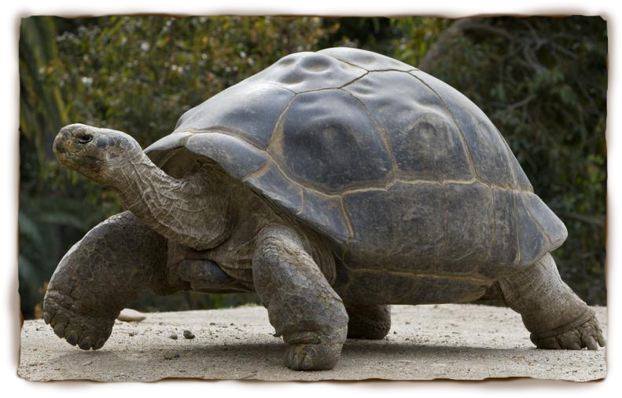
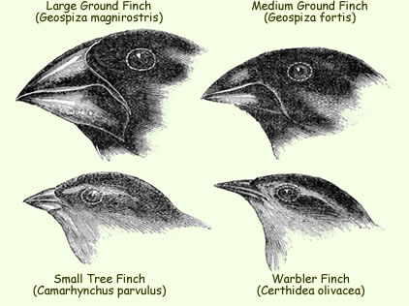
Darwin’s Observations
Islands had different climates
Characteristics of plants and animals varied among islands
  Tortoise shell shape
  Bird beak shape
What could this mean?

Slide 8
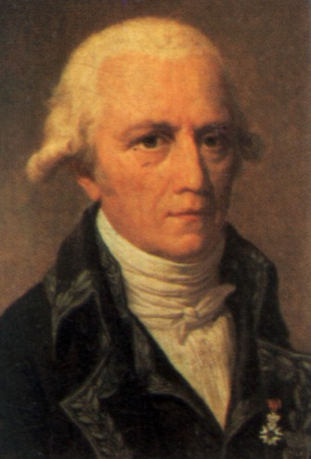
Lamarck’s Theory of Evolution
Jean-Baptiste Lamarck was among one of the first scientists to recognize that life had changed over time.
He proposed that by selective use or disuse of organs, organisms acquired or lost certain traits during their lifetime.
These traits could then be passed on to their offspring. Over time this process led to change in a species.

Slide 9
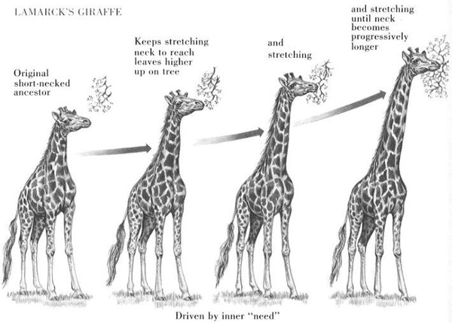
Use and Disuse

Slide 10
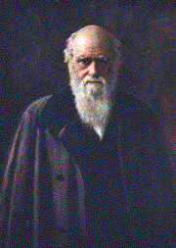
Darwin’s Theory
Darwin began filling notebooks with his ideas.
He was disturbed by his findings.
In 1858 (22 years after the voyage of the Beagle) Alfred Russel Wallace wrote to Darwin about his own observations.
This gave Darwin an incentive to publish his own work.

Slide 11
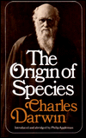
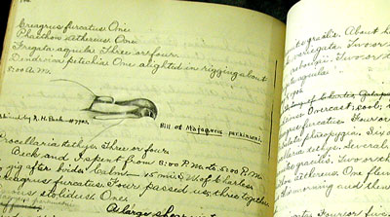
Darwin Publishes
“On the Origin of Species by Natural Selection”
Some considered him to be brilliant, and others strongly opposed and ridiculed his argument.
Set the stage for controversy that has continued to this day

Slide 12
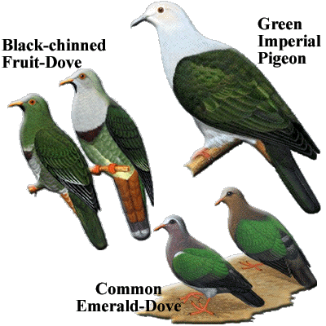
Artificial Selection
People choose which individuals to use for breeding based on the characteristics they would like to see in the offspring.
  Largest hogs
  Fastest horses
  Cows with most milk
Darwin proposed that forces in nature could also influence selection.

Slide 13
Fitness
Fitness—ability of an individual to survive and reproduce in a specific environment.
Individuals with lower levels of fitness die or leave few offspring.
Individuals with high levels of fitness survive and reproduce most successfully.

Slide 14
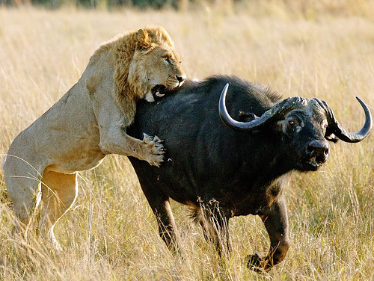
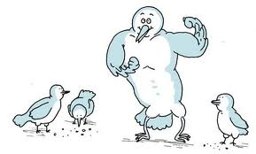
Natural Selection
Natural selection is the process by which organisms with favorable variations survive and produce more offspring than less well-adapted organisms.
Also known as “survival of the fittest.”

Slide 15
Artificial vs. Natural Selection
In both cases, organisms with certain traits survive better than organisms with other traits.
In artificial selection, humans choose which traits are going to be present in the next generation.
In natural selection, nature chooses due to survival of the fittest.

Slide 16
Acquired vs. Genetic Traits
Acquired traits are picked up by an organism throughout life due to environmental conditions.
  Ex. Mouse gets its tail cut off, calluses on hands of a carpenter
Acquired traits are not passed from one generation to the next.
Genetic traits result from genes encoded in the DNA of organisms.
  Ex. Hair color, blood type
Genetic traits are passed from parent to offspring.

Slide 17
Populations, not individuals
Natural selections affects populations, not individuals.
No two individuals in a population are exactly alike. Organisms vary in genetic traits of size, coloration, structural characteristics and behavior.
Individuals with the most adaptive variations survive and pass on those traits to their offspring.
Over time, the population will shift, and there will be more individuals with the adaptation.

Slide 18
Differential Reproductive success
Natural selection causes differential reproductive success.
Individuals with a certain variation will produce more offspring than other individuals in a population.

Slide 19
Evidence of Evolution
Fossil Record
Biogeography
Homologies

Slide 20
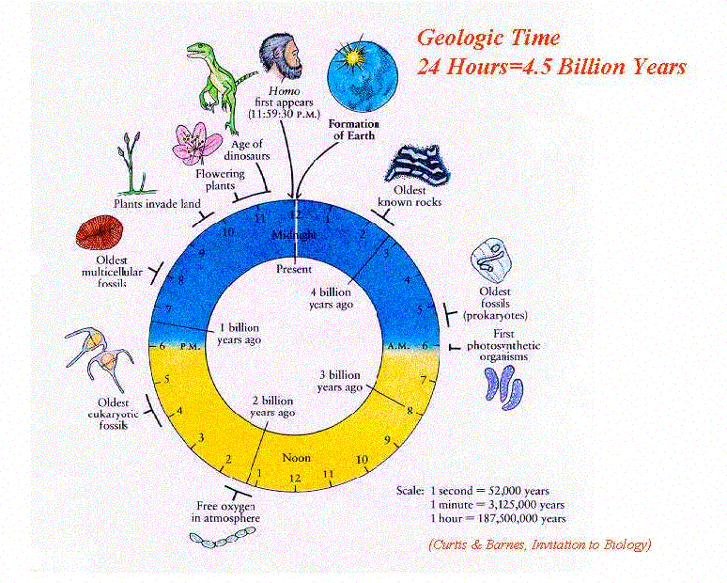
The Fossil Record – Fossils and Ancient Life
The fossil record
provides evidence
about the history of
life on Earth.
It also shows how
different groups of
organisms, including species, have changed over time.
More than 99% of all species that have ever lived on Earth have become extinct.

Slide 21
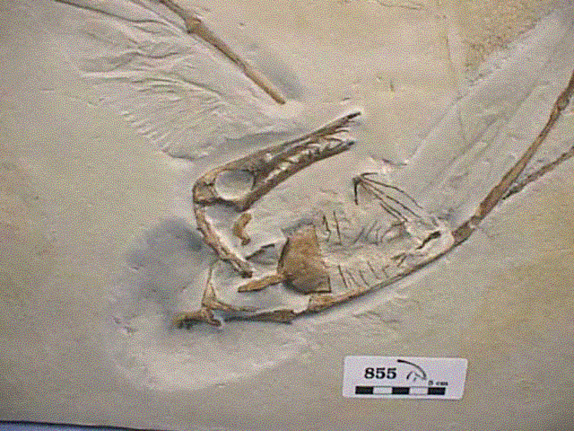
Fossil Record
Scientists use geological and chemical data to date preserved remains of living organisms from the past.
When fossils are arranged chronologically, there is an progressive change in organisms.
Fossil records that are almost complete support they theory of common ancestry.

Slide 22
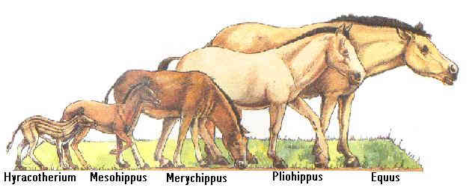
Descent with Modification
Species today look different from their ancestors.
Each has descended, with changes, from other species over time.

Slide 23
Sequential Evolutionary change
The fossil record provides evidence for the theory of sequential evolutionary change within groups over time.
Older fossils are located in lower layers of rock while younger fossils are located closer to the surface.

Slide 24
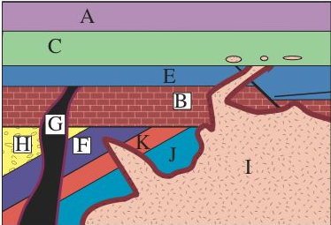
Principle of Original Horizontality
Layers are put down in order.
Youngest on the top, oldest on the bottom.

Slide 25
Gaps in the fossil record
Overall, fossilization rates are low.
Conditions needed for fossilization are very specific.
Organisms with soft bodies or small bones do not fossilize well.
Gaps in the fossil record continue to be filled as new fossils are discovered, but it is likely that the fossils of some species will never be discovered.

Slide 26
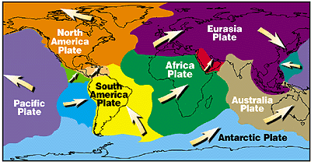
Biogeography
Biogeography is the study of the distribution of species, organisms and ecosystems through geological space and time.
Similar fossils and living species are found on unconnected continents supporting the idea of continental drift.

Slide 27
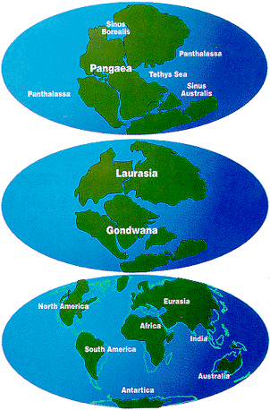
Continental Drift
Continental drift states that there was one land mass (Pangaea) that split into several continents over millions of years.

Slide 28
Homologies
Homologies are similar features between different organisms resulting from common ancestors.
There are three types:
  Anatomical—similar structures
  Molecular—similar stretches of genetic material
  Developmental—similar features in embryos

Slide 29
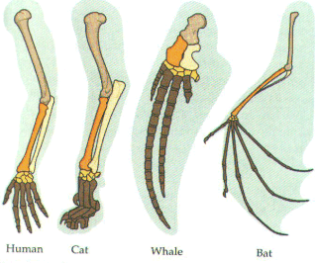
Anatomical Homologies

Slide 30
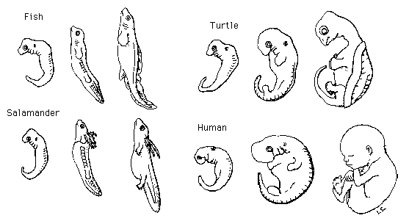
Developmental Homologies

Slide 31
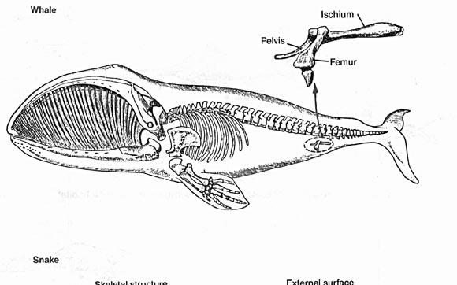
Vestigial Structures
When a structure is no longer needed as populations change and diversify, it often slowly degenerates until it is nonfunctional. These are called vestigial structures.
Ex. Pelvis in a whale
Ex. Human appendix

Slide 32
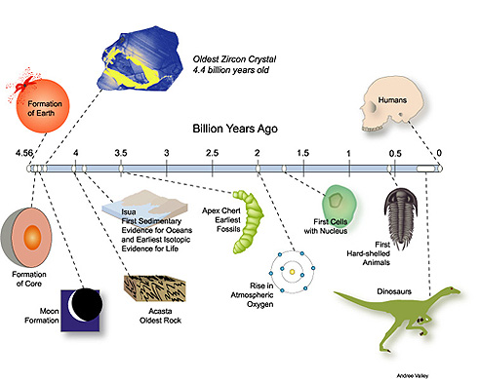
Common Descent
All species, living or extinct, were derived from common ancestors.
A single “tree of life” links all living things.

