Slide 1
Components of dna
Biology EOC (STAAR) Review

Slide 2
DNA Facts
A nucleic acid that stores and transmits the heredity information
DNA is found in all living organisms.
DNA stands for deoxyribonucleic acid.
DNA is referred to as the “blueprint of life” because it contains all the information in a living organism.
DNA molecules are made up of a double helix (“twisted ladder”) containing two strands.
Sugar and Phosphate groups make up the backbone (sides) of the DNA molecule
The bases make up the middle (rungs) of the DNA molecule

Slide 3
DNA Facts….
Genes are pieces of DNA that pass traits to offspring.
DNA is made up of nucleotides which contain a sugar, phosphate group, and a nitrogen base
The 4 bases in DNA are A, C, T, G and they pair up according to Chargaff’s rules; A-T and C-G
The amounts of adenine and thymine found in DNA are equal.
Weak hydrogen bonds hold the DNA nitrogen bases together.

Slide 4
Essential Question
How does the structure of DNA make it possible for traits to be passed on from one generation to another?
The nucleotide bases that are paired on a DNA strand are complementary to each other. When the DNA molecule unzips and unwinds during DNA replication, the exposed strand of bases serves as a template for a new strand. The duplicate strand, when bonded to the old strand, makes an exact copy of the original DNA molecule.

Slide 5
DNA Replication Review

Slide 6
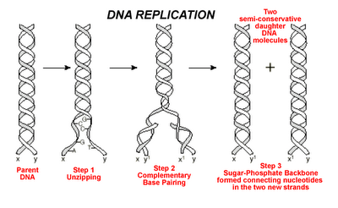

Slide 7
Protein Synthesis Review

Slide 9
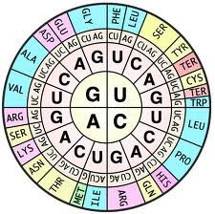
DNA: TAC CCG AAC
mRNA:
AUG GGC UUG
Amino Acids:
Meth Gly Leu

Slide 10
Identify the molecule which contains the instructions used to create an organism’s enzymes and proteins.
a. nicotinamide adenine dinucleotide (NAD+)
b. hemoglobin
c. deoxyribonucleic acid (DNA)
d. glucose

Slide 11
2. RNA molecules use instruction from DNA to assemble proteins. There are three types of RNA molecules: mRNA, rRNA and tRNA. What specific function does mRNA perform in the process of making proteins?
a. It brings instructions from DNA in the cell nucleus to the cytoplasm.
b. It clamps onto messenger RNA and uses its information to assemble amino acids.
c. It transports amino acids to the ribosomes to be assembled into proteins.
d. It creates another molecule of DNA through replication.

Slide 12
3. Which of the following correctly shows a complementary base pair of nitrogenous bases in a DNA molecule?
a. adenine- guanine
b. guanine- cytosine
c. cytosine- adenine
d. guanine- thymine

Slide 13
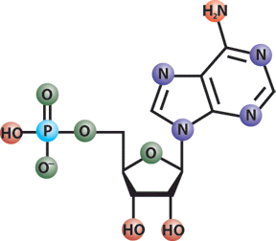
4. DNA is a polymer which is made up of subunits called nucleotides. Nucleotides have three basic parts. Which of these is not a DNA nucleotide component?
a. deoxyribose sugar
b. phosphate group
c. ribose sugar
d. nitrogenous base

Slide 14
5. A nitrogenous base is an important component of the nucleotide making up DNA. Which of the following correctly lists the four possible nitrogenous bases in DNA?
a. adenine, guanine, cytosine, uracil
b. leucine, proline, tyrosine, phenylalanine
c. glutamine, proline, tyrosine, phenylalanine
d. adenine, guanine, cytosine, thymine

Slide 15
6. Translation is crucial to the process of making proteins. Which statement best describes what takes place during translation?
a. An RNA copy of a DNA strand is made.
b. Information in mRNA is converted into a sequence of amino acids in a protein.
c. A copy of chromosomal DNA is created.
d. Instructions from DNA in the nucleus are brought to the cytoplasm.

Slide 16
7. In order for DNA instructions to move from the nucleus to the ribosomes in the cytoplasm of a cell, an RNA copy of a DNA strand must be made. This process, which takes place in the cell nucleus, is called-
a. translation
b. DNA replication
c. mutation
d. transcription

Slide 17
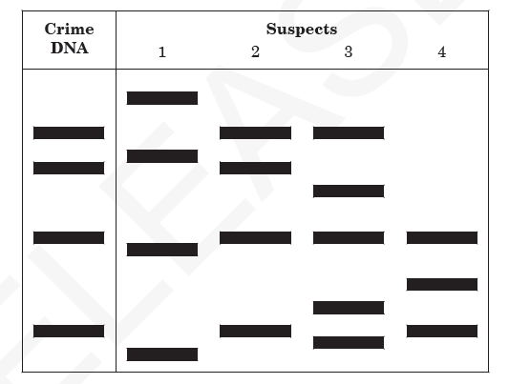
8. This diagram represents samples of DNA that were cut with a restriction enzyme during DNA fingerprinting in a crime lab.
Which technique was used to produce these bands?
a. cloning
b. gel electrophoresis
c. gene splicing
d. genetic engineering

Slide 18
9. A scientist treats a cell with a chemical that destroys the ribosomes. As a result, which cell process will be stopped?
a. osmosis
b. photosynthesis
c. protein synthesis
d. respiration

Slide 19
10. A sugar, a phosphate group, and a nitrogen base form the building blocks of which organic compound?
a. carbohydrates
b. lipids
c. nucleic acids
d. proteins

Slide 20
11. During DNA replication, which of the following segments would be complementary to the original DNA segment of CCTAAT?
a. CGATTA
b. GGUTTU
c. GGATTA
d. GGAUUA

Slide 21
12. What type of RNA is responsible for bringing amino acids to the ribosome for protein synthesis?
a. messenger RNA
b. transfer RNA
c. ribosomal RNA
d. mitochondrial RNA

Slide 22
13. If a portion of a DNA strand has the base sequence TACGCA, what will be the base sequence of the mRNA strand transcribed?
a. TACGCA
b. UACGCA
c. AUGCGU
d. ATGCGT

Slide 23
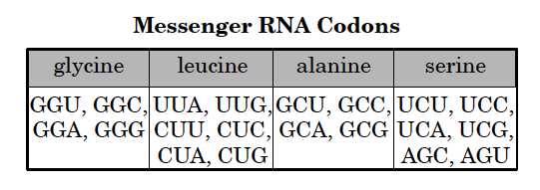
14. The chart to the right matches messenger RNA codons with amino acids.
DNA strand has the codon TCA. According to the chart, the corresponding messenger RNA codes for which of the following amino acids?
a. glycine
b. leucine
c. alanine
d. serine

Slide 24
15. Albinism is a genetic mutation that results in some animals being born without the enzyme that produces the pigment for skin and eye color. Which of the following best explains this mutation?
a. The DNA failed to replicate.
b. The deoxyribose sugar became separated from the DNA.
c. The genetic code change caused the wrong protein to form.
d. The RNA necessary to produce proteins was not present.

Slide 25
16. How do the functions of DNA and RNA differ?
a. DNA directs protein transport, while RNA aids in energy production.
b. DNA aids in energy production, while RNA directs protein transport.
c. DNA stores genetic information, while RNA relays genetic information for protein synthesis.
d. DNA relays genetic information for protein synthesis, while RNA stores genetic information.

Slide 26
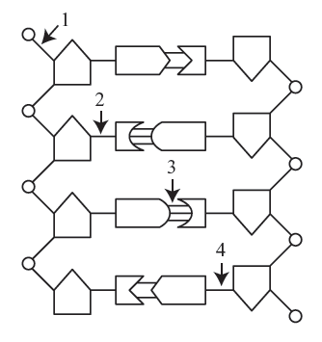
17. The graphic below represents a segment of DNA.
Which bond must be broken if DNA replication is to occur?
a. 1
b. 2
c. 3
d. 4

Slide 27
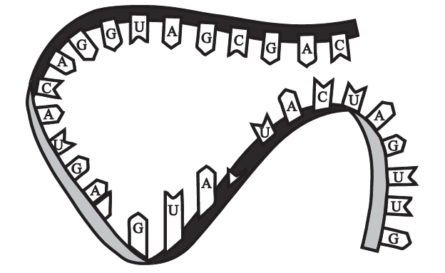
18. The figure to the right shows genetic material.
What information confirms that this is an RNA molecule?
a. The molecule contains adenine.
b. The molecule is single-stranded.
c. The molecule has hydrogen bonds.
d. The molecule has a sugar-phosphate backbone.

Slide 28
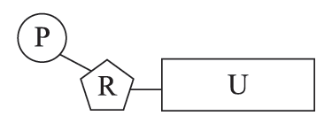
19. The figure to the right shows an RNA molecule found within the cell.
What does the letter U represent in this nucleotide?
a. ribose sugar
b. nitrogen base
c. phosphate group
d. deoxyribose sugar

Slide 29
20. What is the role of hydrogen bonds in the structure of DNA?
a. to code for proteins
b. to synthesize proteins
c. to separate the strands
d. to connect the base pairs

