Slide 1
DNA and Protein Synthesis (STAAR Review)

Slide 2
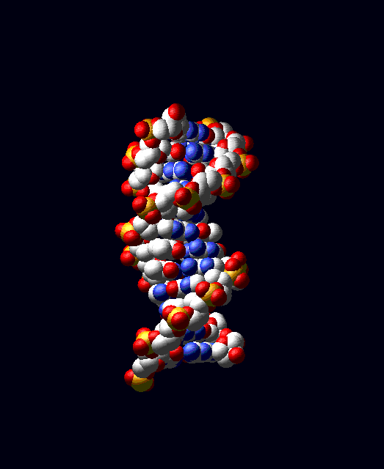
DNA: DEOXYRIBONUCLEIC ACID DOUBLE STRANDED MONOMER: NUCLEOTIDE

Slide 3
STRUCTURE OF A NUCLEOTIDE
a. Adenine
1. Phosphate
b. Thymine
c. Cytosine
d. Guanine
2. Deoxyribose
3. Nitrogen Base

Slide 4
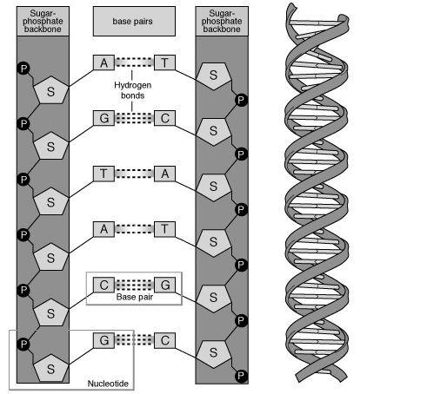
STRUCTURE OF DNA
-BACKBONE IS MADE OF ALTERNATING SUGAR AND PHOSPHATE
-THE RUNGS ARE MADE OF TWO COMPLEMENTARY NITROGEN BASES

Slide 5
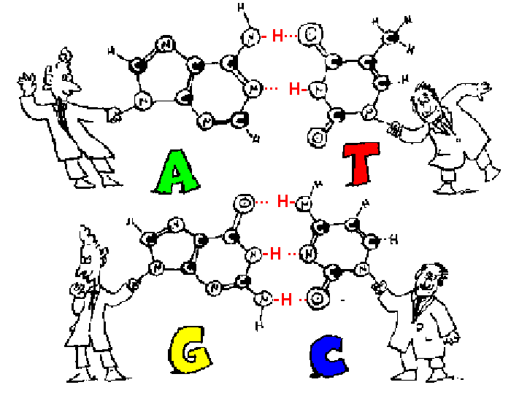
COMPLEMENTARY BASE PAIRING RULES

Slide 6
PRACTICE WITH BASE PAIRING
Sugar and Phosphate
A T C G G C T A C G A T
T A G C C G A T G C T A
Sugar and Phosphate

Slide 7
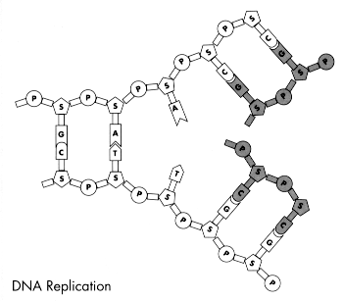
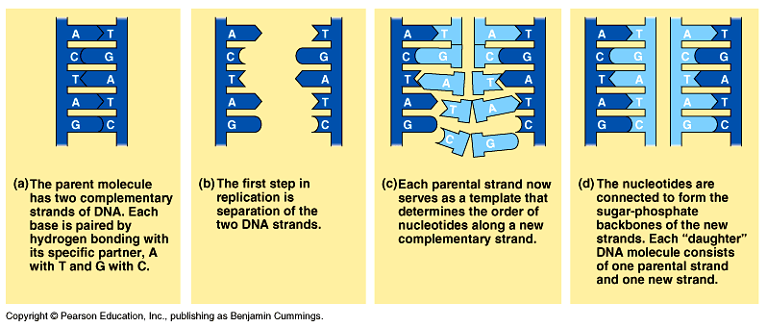
DNA REPLICATION
Process of DNA copying itself
Steps
DNA Unzips (Hydrogen bonds break)
Each side acts as a template
New DNA nucleotides are added according to base-pairing rules
Two new molecules of DNA result – each with one old and one new strand.
Happens in INTERPHASE (before mitosis or meiosis)

Slide 8
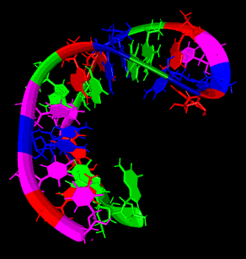
RNA
Ribonucleic Acid
Single Stranded
MONOMER
Nucleotide

Slide 9
RNA NUCLEOTIDE
A
Phosphate
Nitrogen Base
C
B
Guanine
Cytosine
Ribose
Adenine
Uracil

Slide 10
WHAT ARE THE TYPES OF RNA?

Slide 11
MRNA FUNCTION
Copy a message from a gene on DNA by transcription
DNA
mRNA

Slide 12
rRNA FUNCTION
Reads the message on the mRNA
DNA
mRNA
rRNA

Slide 13
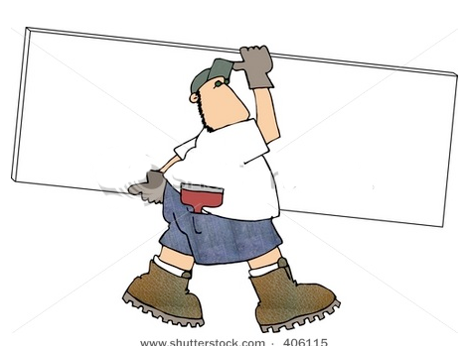
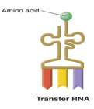
tRNA FUNCTION
Carries amino acids to mRNA - translation
Amino Acids
mRNA

Slide 14
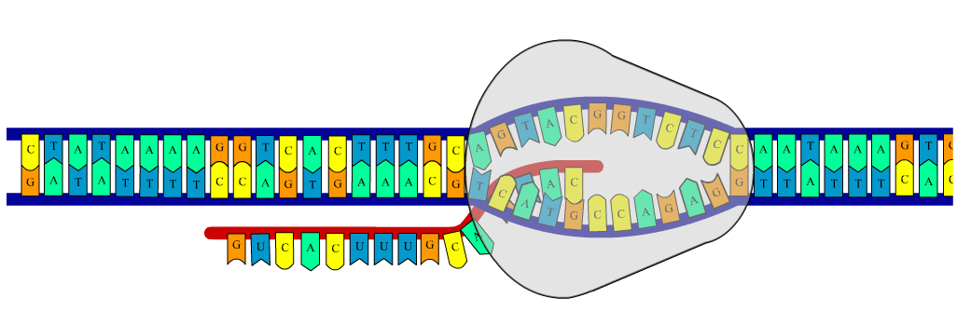
PROTEIN SYNTHESIS
Genes (DNA) contain the instruction for making a protein
In transcription, DNA is used to make mRNA in the nucleus
mRNA then leaves the nucleus and goes to the ribosome
In translation, tRNA then brings amino acids in the proper order to make the protein on the ribosome.
DNA → mRNA → protein
Click here for transcription animation
Click here for translation animation

Slide 15
TRANSCRIBE AND TRANSLATE THE FOLLOWING
DNA
TAC GGC AAA TAG TTT CCA TTA AGT
AUG CCG UUU AUC AAA GGU AAU UCA
mRNA
Met Pro Phe ILe Lys Gly Asn Ser
Amino
acids

Slide 16
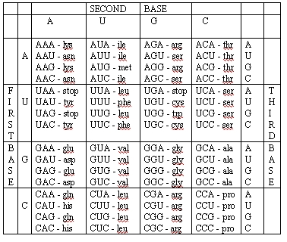
READING THE CODON CHART
Be sure to use mRNA
You won’t have to memorize this!
What amino acid is coded for by the DNA
ATA GAG
First convert DNA to mRNA
ATA GAG UAU CUC
UAU = tyr
CUC = Leu

Slide 17
TRANSLATION LOOKS LIKE
Amino acid
Protein
Peptide Bond
Anticodon
Met
Gly
Ser
Ser
Arg
Stop
UAC
GCG
CCU
AGG
AGU
AUU
AUG CGC GGA UCC UCA UAA
mRNA
Ribosome
Codon
Codon
First tRNA leaves and the ribosome shifts. A
new tRNA fills empty space.
rRNA forms a peptide bond between the
amino acids
A tRNA anticodon matches with a mRNA codon
Three base sequence in mRNA is called a codon
A ribosome attaches to mRNA
Another peptide bond is formed and the
process continues
Another tRNA anticodon matches with a codon
A protein has been made

Slide 18
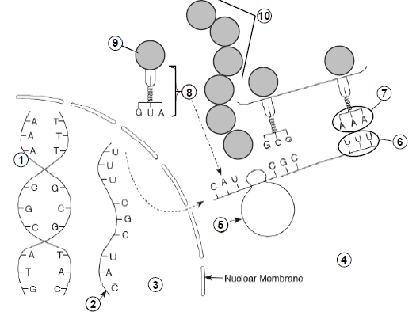
CAN YOU IDENTIFY THE PARTS?
DNA
mRNA
Nucleus
Cytoplasm
Ribosome
Codon
Anticodon
tRNA
Amino acid
Protein (polypeptide)

Slide 19
1. Which of the following correctly shows a complementary base pair of nitrogenous bases in a DNA molecule?
a. adenine- guanine
b. guanine- cytosine
c. cytosine- adenine
d. guanine- thymine

Slide 20
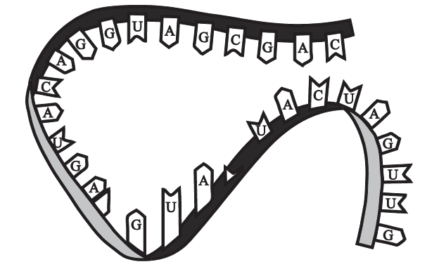
2. The figure to the right shows genetic material.
What information confirms that this is an RNA molecule?
a. The molecule contains adenine.
b. The molecule is single-stranded.
c. The molecule has hydrogen bonds.
d. The molecule has a sugar-phosphate backbone.

Slide 21
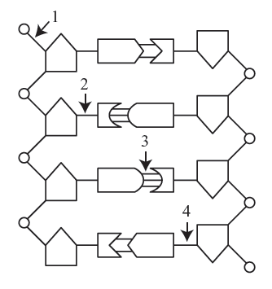
3. The graphic below represents a segment of DNA.
Which bond must be broken if DNA replication is to occur?
a. 1
b. 2
c. 3
d. 4

Slide 22
4. RNA molecules use instruction from DNA to assemble proteins. There are three types of RNA molecules: mRNA, rRNA and tRNA. What specific function does mRNA perform in the process of making proteins?
a. It brings instructions from DNA in the cell nucleus to the cytoplasm.
b. It clamps onto messenger RNA and uses its information to assemble amino acids.
c. It transports amino acids to the ribosomes to be assembled into proteins.
d. It creates another molecule of DNA through replication.

Slide 23
5. Translation is crucial to the process of making proteins. Which statement best describes what takes place during translation?
a. An RNA copy of a DNA strand is made.
b. Information in mRNA is converted into a sequence of amino acids in a protein.
c. A copy of chromosomal DNA is created.
d. Instructions from DNA in the nucleus are brought to the cytoplasm.

Slide 24
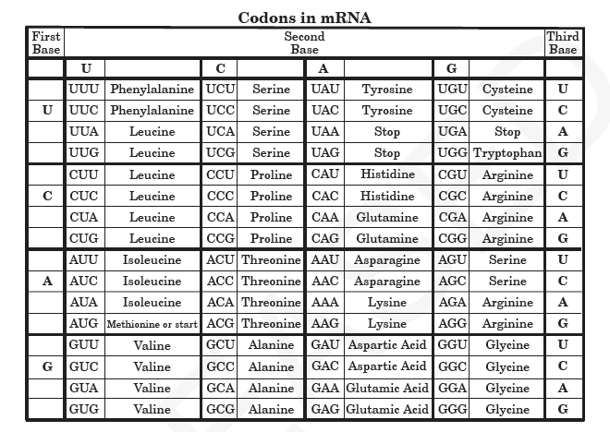
6. This chart represents amino acids that are coded from different combinations of mRNA codons.
Which amino acid sequence can be coded from the DNA sequence CAG TAG CGA?
a. Valine- Isoleucine- Glycine
b. Valine- Aspartic Acid- Alanine
c. Valine- Isoleucine- Alanine
d. Valine- Phenylalanine- Alanine

