Slide 1
Dihybrid Crosses

Slide 2
Dihybrid Crosses
In monohybrid crosses, we were only concerned with one trait at a time—for example, plant height or fur color.
In dihybrid crosses we will be considering two traits at the same time—for example, plant height and flower color, or fur color and tail length.

Slide 3
#1 Bunny Genotypes
Because we are considering two traits at the same time, each organism will have four genes instead of two. Ex. AaBb
The first two letters are for the first trait, and the second two letters are for the second trait.
In bunnies, black (B) is dominant to white (b) and rough coat (R) is dominant to smooth coat (r.)

Slide 4
Homozygous black smooth bunny
BB for homozygous black
rr for smooth
The genotype will be BBrr.
White smooth bunny
bb for white
rr for smooth
The genotype will be bbrr.

Slide 5
Heterozygous black rough bunny
Bb for heterozygous black
Rr for heterozygous rough
The genotype will be ________.
Homozygous black rough bunny
BB for homozygous black
_____ for homozygous rough
The genotype will be ________.
Complete the last two on your own.

Slide 6
#2 Gamete Formation
In order to set up the Punnett Square for a dihybrid cross we must first list out the gametes formed by each parent.
When a AaBb parent forms gametes, it will pass on two genes: one “a” gene and one “b” gene to each offspring.
It could pass on A and B, a and b, a and B, or A and b.

Slide 7
FOIL Method
You may have learned the foil method in algebra. It stands for first, outer, inner and last. You can use this method to find all possible gametes of a dihybrid individual.
Ex. HhWw
FIRST: HhWw
OUTER: HhWw
INNER: HhWw
LAST: HhWw
Gametes for this parent are HW, Hw, hW, hw.

Slide 8
AABb
Gametes will be AB, Ab, AB, Ab
*In this individual, both of the “a” alleles are dominant. The first two gametes use the first “A” and the second two use the second “A.”
* It is necessary to write all gametes even though they are repeats because we will need all four in the Punnett Square.

Slide 9
aabb
This one is easy. All four gametes will be the same. What will they be?
AaBB
Gametes will be AB, aB, _____, _____
AAbb
Another one where all four gametes will be the same. What will they be?

Slide 10
#3 Manx and Albino Cats
Manx cats are dominant to cats having a tail. Normal coloration is dominant to albinism.
Cross two heterozygous cats with normal coloration are mated.
We’ll use M for manx, m for having a tail. C for normal coloration and c for albinism.
What is the genotype for each parent?

Slide 11
The genotype cross will be MmCc x MmCc since both cats are heterozygous for both traits.
Now we need to determine the gametes these cats will form. (Use the foil method.)
Each cat will make the same gametes: MC, Mc, mC, and mc.

Slide 12
Because we have four gametes for each parent, we will need a 16 square Punnett Square.
The gametes for one parent will go across the top, and the gametes for the other parent will go along the left side, just as they did in monohybrid crosses.

Slide 13
Here is what the Punnett Square should look like.

Slide 14
To complete the Punnett square, we will use the same method we used with monohybrid crosses: what is on the top comes down, and what is on the side comes over.
Each offspring will receive two alleles from each parent and will end up with a total of four alleles, just like the parents.
Always keep the genes separate—”a” alleles go together, “b” alleles go together. Ex. AaBb, Not: ABab

Slide 15
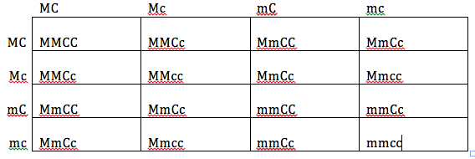
Here is the completed Punnett Square for #3.

Slide 16
Phenotypic Ratio
A phenotypic ratio tells us how many of each phenotype is present in the offspring.
In this cross, we have four possibilities:
Manx and normal colored
Manx and albino
Tailed and normal colored
Tailed and albino

Slide 17
To be manx and normal colored, the offspring need to have at least one “M” and one “C.”
There are four offspring with both of these traits.

Slide 18
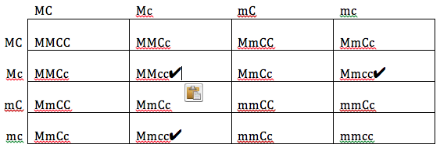
To be manx and albino, the offspring must have at least one “M” and two “c” alleles.
There are three offspring with these traits.

Slide 19
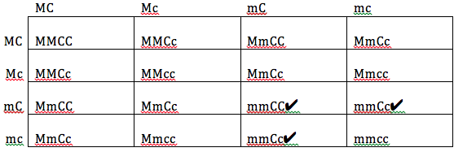
To have a tail and be normal colored, offspring must have two “m” alleles and at least one “C.”
There are three offspring with these traits.

Slide 20
Lastly we have the cats with tails and albinism. They must have two “m” alleles and two “c” alleles.
There is only one offspring with both of these traits.

Slide 21
Our phenotypic ratio, then is 9:3:3:1.
You will find this ratio is true every time you have two parents who are heterozygous for both traits.
Now for the genotypic ratio. Count the number of offspring that are MMCC, MMCc, MMcc, MmCC, MmCc, Mmcc, mmCC, mmCc and mmcc.

Slide 22
MMCC: 1, MMCc: 2, MMcc: 1, MmCC: 2, MmCc: 4, Mmcc: 2, mmCC: 1, mmCc: 2, mmcc: 1
Our genotypic ratio is therefore 1:2:1:2:4:2:1:2:1
This genotypic ratio is also always true IF both parents are heterozygous for both traits.

Slide 23
#4 Freckles and Dimples
Since freckles is dominant, we’ll use F for freckles and f for no freckles.
Dimples is also dominant so what letter will be use for dimples? no dimples?
The worksheet should say the first person is homozygous for both traits. Their genotype would be FFDD.
The second person does not have either trait. What is their genotype?

Slide 24
Now we need to make gametes. This will be easy since both parents are homozygous for both traits.
The FFDD parent will make four gametes, and all four will be FD.
The ffdd parent will make four gametes, and all four will be _____.
Place these gametes on the Punnett Square.

Slide 25
Every offspring will receive FD from one parent and fd from the other parent.
Therefore, every offspring in this Punnett Square will have the genotype: __________.
What will their phenotype be? (Will they have freckles? dimples?)

Slide 26
#5 Crossing the F1
Every offspring in #4 was FfDd so the genotype cross for #5 will be FfDd x FfDd.
Determine the gametes for each parent. Use the foil method if needed. There will be four different gametes.
Put these gametes in the Punnett Square and complete the cross.
Find the phenotypic and genotypic ratios.

