Slide 1
Cellular Respiration
From sugar to ATP

Slide 2
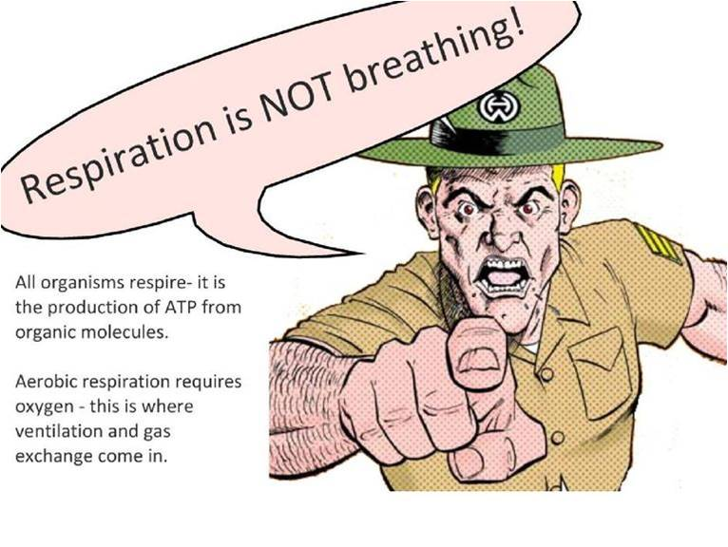

Slide 3
Cellular Respiration
Cellular respiration is the process by which living things release energy from sugars.
Once released, the energy is stored within ATP.
Both autotrophs and heterotrophs utilize cellular respiration.

Slide 4
Anaerobic vs. Aerobic
Cellular respiration can occur aerobically or anaerobically.
Aerobic—oxygen is required
Anaerobic—oxygen is not required.

Slide 5
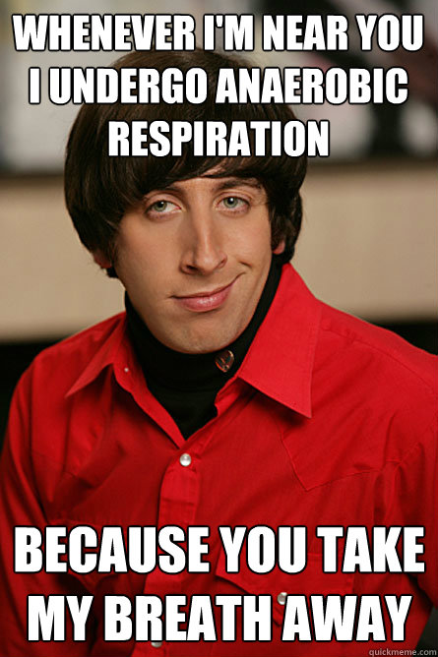
Anaerobic Respiration
Two Steps:
Glycolysis
Lactic Acid Fermentation OR Alcoholic Fermentation

Slide 6
Glycolysis
Occurs in the cytoplasm of the cell
Does not require oxygen
Breaks down glucose into 2 pyruvic acids
Makes 4 ATP
Uses 2 ATP
Net Gain of 2 ATP

Slide 7
Lactic Acid Fermentation
Human muscle cells during extended periods of exercise
Does not require oxygen
End product is lactic acid
No ATP is produced

Slide 8
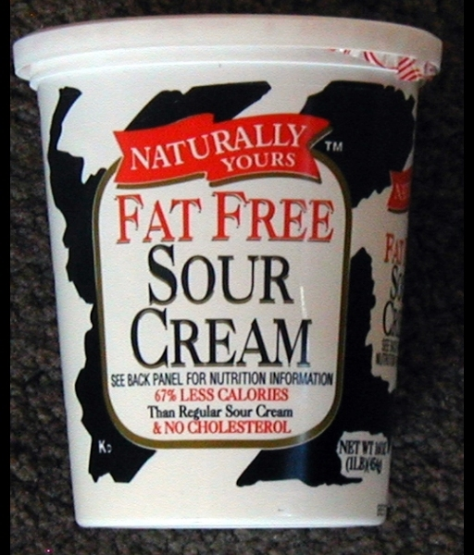
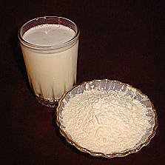
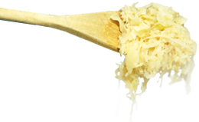
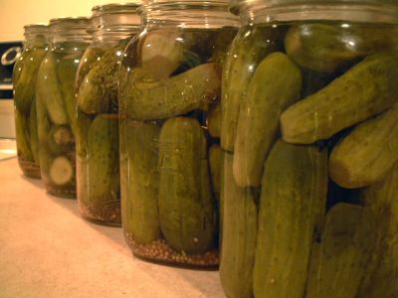
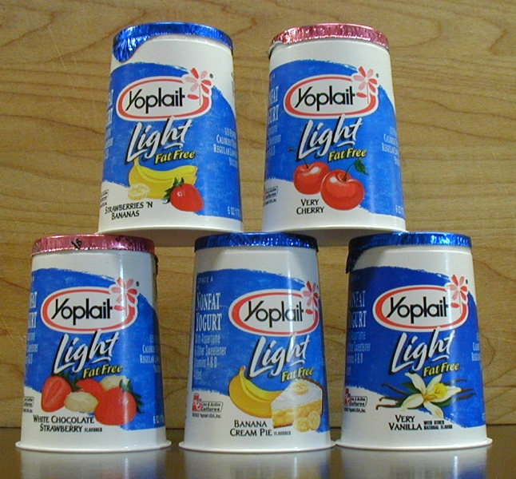
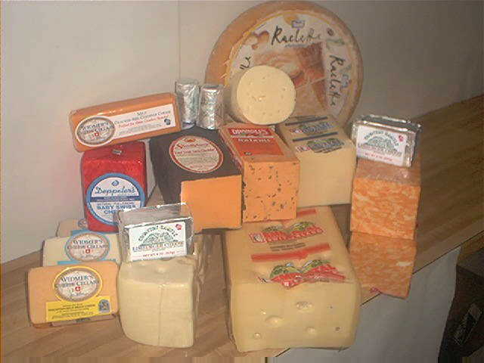
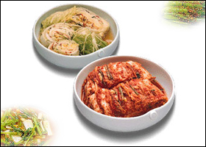
Many foods are produced by lactic acid fermentation:

Slide 9
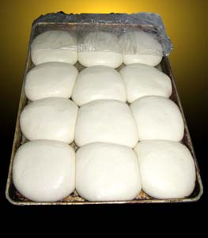
Alcoholic Fermentation
Occurs in anaerobic bacteria and fungi such as yeast
Does not require oxygen
Responsible for bread rising and for producing alcohol
End products are ethyl alcohol and CO₂
No ATP is produced

Slide 10
Let’s do the math!
Anaerobic Respiration
Glycolysis 2 ATP
Fermentation 0 ATP
Total 2 ATP

Slide 11
Review Question
How do alcoholic and lactic acid fermentation differ?
Alcoholic fermentation produces alcohol and carbon dioxide. Lactic acid fermentation produces lactic acid.

Slide 12
Aerobic Respiration
Three Steps:
Glycolysis
Citric Acid Cycle (Kreb’s Cycle)
Electron Transport Chain

Slide 13
Glycolysis (same as anaerobic)
Occurs in the cytoplasm of the cell
Does not require oxygen
Breaks down glucose into 2 pyruvic acids
Makes 4 ATP
Uses 2 ATP
Net Gain of 2 ATP

Slide 14
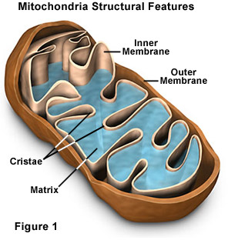

Slide 15
Citric Acid Cycle
Occurs in matrix of mitochondrion
Oxygen is required
Pyruvic acid is made into citric acid
(Nine more chemical reactions take place)
CO₂ is produced

Slide 16
Electron Transport Chain
Occurs in inner folds of mitochondrion (cristae)
Oxygen is required
H⁺ electrons are passed along a chain
Oxygen is the final electron acceptor (which forms H₂O)
Yields 34 ATP

Slide 17
Math again!
Aerobic Respiration
Glycolysis 2 ATP
Citric acid cycle
and ETC 34 ATP
Total 36 ATP

Slide 18
Review Question
Compare the ATP yields of aerobic and anaerobic respiration.
Anaerobic respiration produces 2 ATP molecules. Aerobic respiration produces 36 ATP molecules.

Slide 19
Comparing Photosynthesis and Cellular Respiration
 | Photosynthesis | Respiration
Function
Location
Reactants
Products
Organisms

Slide 20
Comparing Photosynthesis and Cellular Respiration
 | Photosynthesis | Respiration
Function | Energy capture | Energy release
Location
Reactants
Products
Organisms

Slide 21
Comparing Photosynthesis and Cellular Respiration
 | Photosynthesis | Respiration
Function
Location | Chloroplasts | Mitochondria
Reactants
Products
Organisms

Slide 22
Comparing Photosynthesis and Cellular Respiration
 | Photosynthesis | Respiration
Function
Location
Reactants | Carbon dioxide and water | Sugar and oxygen
Products
Organisms

Slide 23
Comparing Photosynthesis and Cellular Respiration
 | Photosynthesis | Respiration
Function
Location
Reactants
Products | Sugar and oxygen | Carbon dioxide and water
Organisms

Slide 24
Comparing Photosynthesis and Cellular Respiration
 | Photosynthesis | Respiration
Function
Location
Reactants
Products
Organisms | Plants, algae and some bacteria | All eukaryotes and some prokaryotes

Slide 25
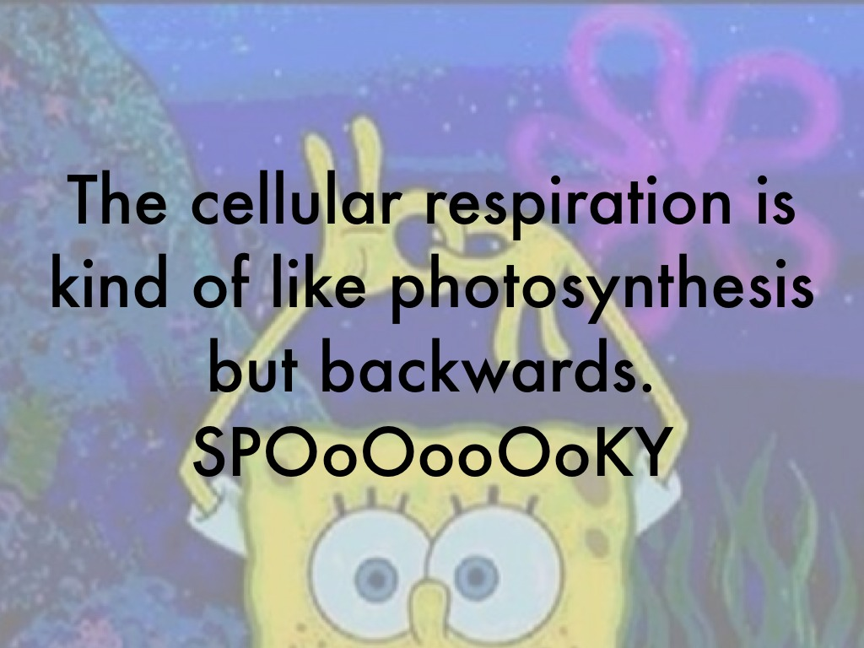

Slide 26
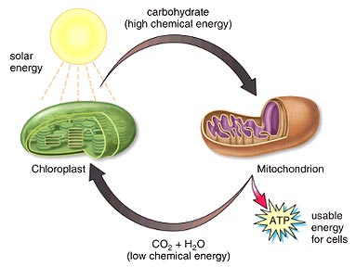

Slide 27
Equations
Photosynthesis
6CO₂ + 6H₂O + energy → C₆H₁₂O₆ + 6O₂
Respiration
C₆H₁₂O₆ + 6O₂ → 6CO₂ + 6H₂O + energy

