Slide 1
The Cell Membrane
Passive and Active Transport

Slide 2
Question
All cells contain:
Genetic information
Cytoplasm
Cell membrane

Slide 3
The Cell Membrane
All cells contain a cell membrane (plasma membrane.)
Function:
Encloses a cell and separates its contents from its surroundings
Allows for the passage of materials into and out of the cell.
Both of these functions serve to maintain homeostasis.
The membrane is composed of a phospholipid bilayer embedded with proteins.

Slide 4
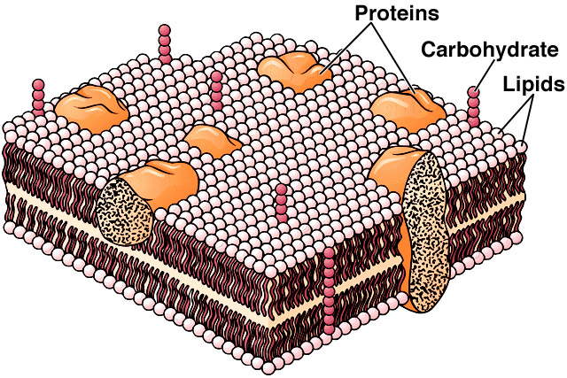
Bilayer?
Nearly all cell membranes are composed of a lipid bilayer —made up of two layers of lipid molecules.

Slide 6
The Plasma Membrane
Proteins are also imbedded in the lipid bilayer. They help move material across the membrane.
Carbohydrate molecules may be attached to the proteins for chemical identification.

Slide 7
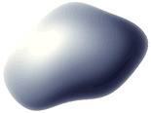
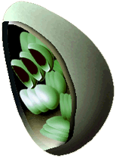
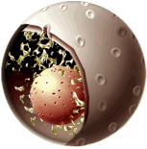
Cell Organelles
The nucleus, vacuoles, mitochondria and chloroplasts are also enclosed by membranes.
The type and arrangement of proteins and lipids in these membranes varies so each membrane has its own permeability properties.

Slide 8
What about cell walls?
Do all cells have them?
Only plants, fungi, bacteria and some protists (algae)
How is it different from a cell membrane?
Cell walls are made from fibers of carbohydrate and protein.
Anything that fits through a cell wall’s pores can pass through.
What are the main functions?
Support and protect the cell

Slide 9
What happens when perfume is sprayed in the corner of the classroom?

Slide 10
Concentration
Concentration: the amount of the substance dissolved (solute) in a unit of the other substance (solvent.)
Concentration Gradient: the difference in concentration of a particular molecule between two regions.
The net movement of molecules tends to be down the concentration gradient—from an area of high concentration to an area of low concentration.

Slide 11
Movement down the concentration gradient
High
Low

Slide 12
Passive Transport—NO energy required!

Slide 13
Brownian Motion
Robert Brown, 1827
Noticed the random motion of particles under a microscope.

Slide 14
Passive Transport
The process of moving molecules using concentration gradients instead of energy
Three types:
Diffusion
Facilitated diffusion
Osmosis

Slide 15
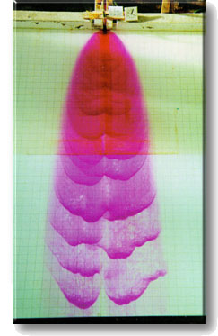
Diffusion
The net movement of molecules down a concentration gradient
The simplest form of cellular transport

Slide 16
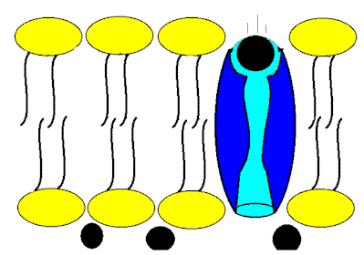
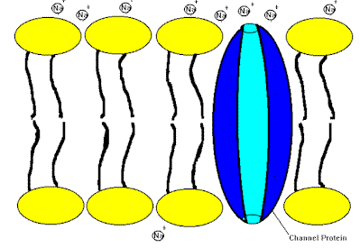
Facilitated Diffusion
Movement of molecules down a concentration gradient with the aid of membrane proteins
There is no energy used during facilitated diffusion.

Slide 17
Osmosis is the diffusion of water.

Slide 18
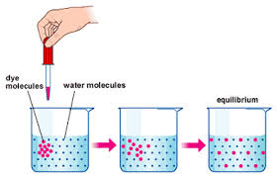
The Result?
Equilibrium
Molecules continue to collide, but there is no change in concentration.

Slide 19
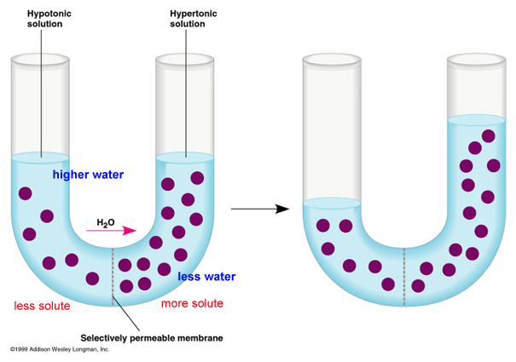

Slide 20
Solutions
Described by comparing concentrations of the cell’s internal and external environments
Concentrations are equal—ISOTONIC
If they are unequal—more concentrated is HYPERTONIC, and less concentrated is HYPOTONIC

Slide 21
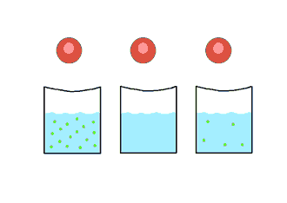
Solutions Demonstration

Slide 22
Effects of Solutions on Cells
If the solution is | The cell will
ISOTONIC | be in equilibrium
HYPERTONIC | lose water and shrivel
HYPOTONIC | swell and possibly rupture

Slide 23
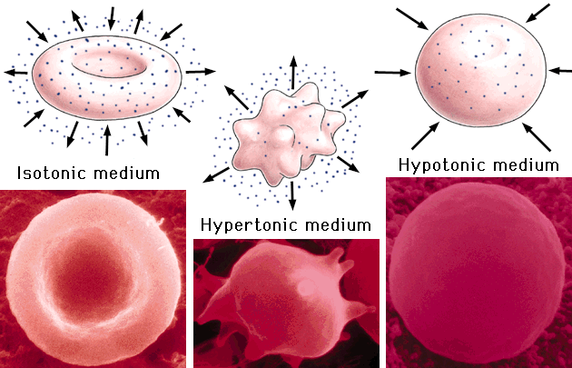

Slide 24
Cell Preferences
Animal cells function best in isotonic environments.
Plant cells, however, function best when the environment is hypotonic.
Cell wall prevents too much water from entering
Large vacuole allows for storage of water
The OSMOTIC PRESSURE of hypotonic environments results in TURGOR, which allows plants to stand upright.

Slide 25
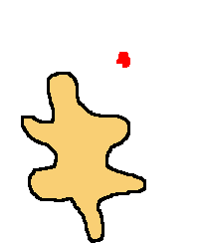
Sometimes diffusion just isn’t fast enough…

Slide 26
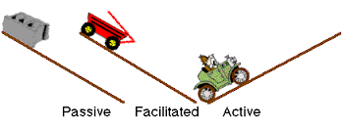

Slide 27
Active Transport
Some molecules must be transported against the concentration gradient (from low to high concentration
Active transport is the process of moving molecules across the cell membrane by using energy.
Active transport requires the use of membrane proteins.

Slide 28
Endocytosis
Endocytosis—the cell membrane stretches to surround the needed material, forming a vacuole around it
Ex. A white blood cell consuming a bacterium

Slide 29
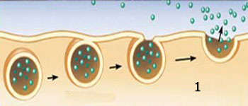
Exocytosis
Exocytosis—a vacuole containing material such as proteins or enzymes fuses with the cell membrane to expel the material out of the cell
Ex. Pancreas cell releasing digestive enzymes

Slide 30
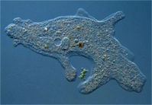

Slide 31
Osmosis vs. Diffusion
Alike
Different
Energy is not required
Move from high to low concentration
Osmosis is the diffusion of water

Slide 32
Facilitated Diffusion vs. Active Transport
Alike
Different
Move materials through membrane proteins
Active transport requires energy
Active transport moves from low to high concentration

Slide 33
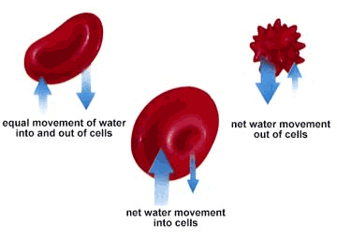
Name that Solution!!!
isotonic
hypertonic
hypotonic
Choices:
Isotonic
Hypertonic
Hypotonic

